Slide 1
SMS Spam Detection and Analysis
Knowledge Discovery and Data Mining: Project 5
UMESH NAIR

Slide 2
Data Set
SMS Spam Collection from UCI Machine Learning Repository
Set of SMS messages that have been collected for mobile phone spam research.
5572 English text messages, labelled accordingly as ham(legitimate) or spam(irrelevant).
Out of the total, there are 4825 ham messages and 747 spam messages.

Slide 3
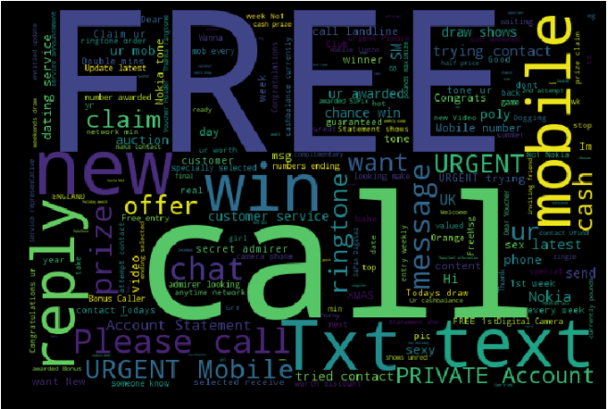
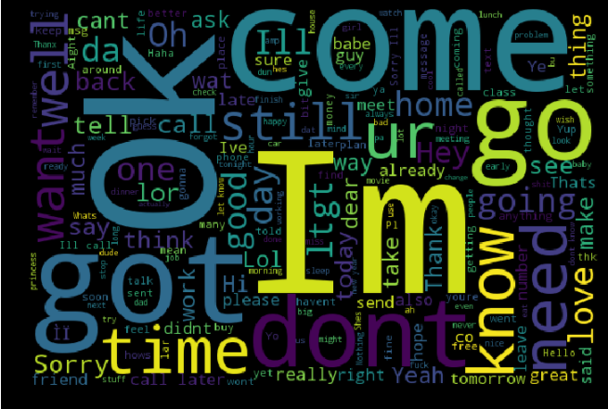
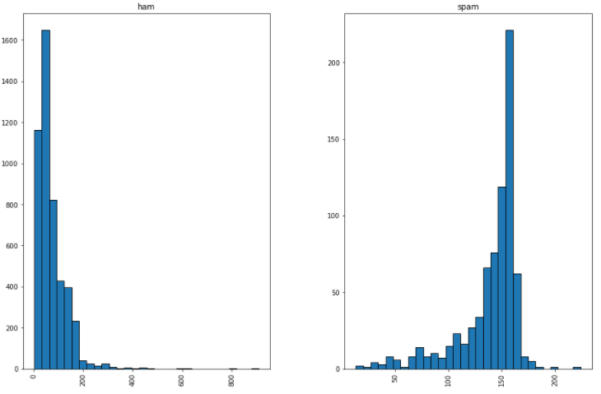
Data Exploration
Spam Text Word Cloud
Ham Text Word Cloud
Histogram of length of ham and spam messages

Slide 4
Guiding Questions

Slide 5
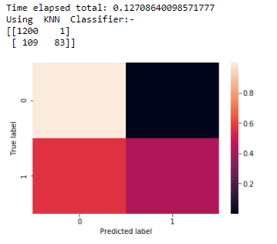
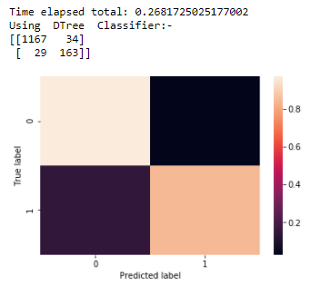
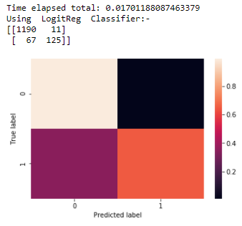
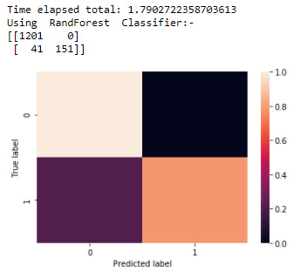
1. How accurately can an SMS message be classified as spam or otherwise?
Method | Accuracy Score
KNN | 0.921
Decision Tree | 0.955
Logistic Regression | 0.944
Random Forest | 0.971

Slide 6
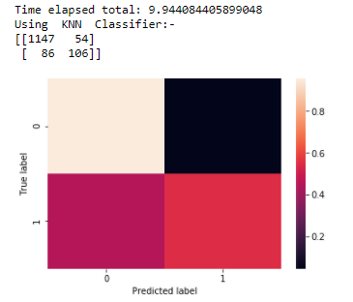
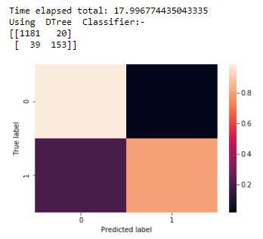
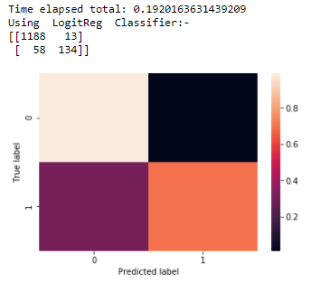
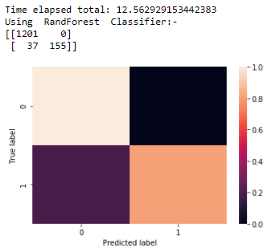
Also considering message length:-
Method | Accuracy Score 1 | Accuracy Score 2
KNN | 0.921 | 0.899
Decision Tree | 0.955 | 0.958
Logistic Regression | 0.944 | 0.949
Random Forest | 0.971 | 0.973

Slide 7
2. How accurately can spam messages be further classified into subcategories?
Manually segregated and labelled spam messages into 6 categories.
Based on specific keywords present in the text message.
Categories and their count:
Free: 121
Lottery: 175
Carrier Offers: 82
Adult: 57
Attention: 72
Other: 240

Slide 8
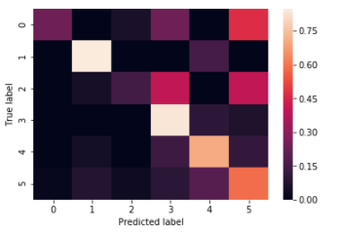
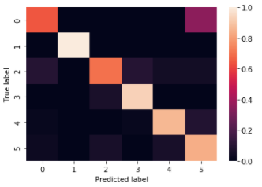
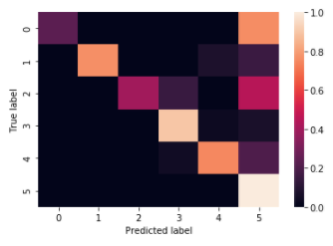
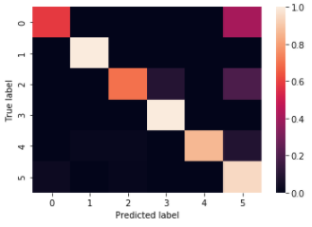
KNN
Method | Accuracy Score
KNN | 0.594
Decision Tree | 0.84
Logistic Regression | 0.775
Random Forest | 0.882
Decision Tree
Logistic Regression
Random Forest

Slide 9
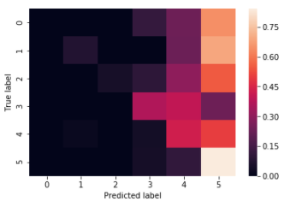
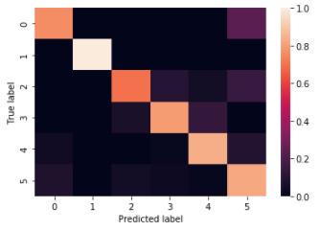
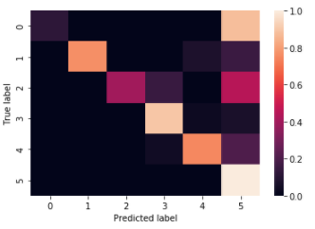
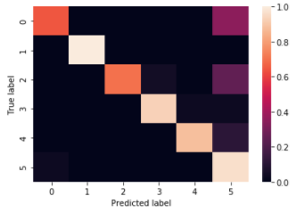
Also considering message length:-
KNN
Decision Tree
Method | Accuracy Score 1 | Accuracy Score 2
KNN | 0.594 | 0.455
Decision Tree | 0.84 | 0.818
Logistic Regression | 0.775 | 0.765
Random Forest | 0.882 | 0.888
Logistic Regression
Random Forest

Slide 10
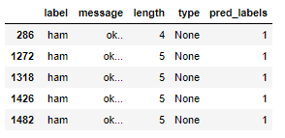
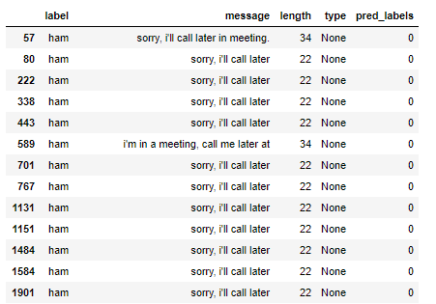
3. Is it possible to cluster the text messages into meaningful and well-defined groups?
K-Means: 2 clusters and outliers

Slide 11
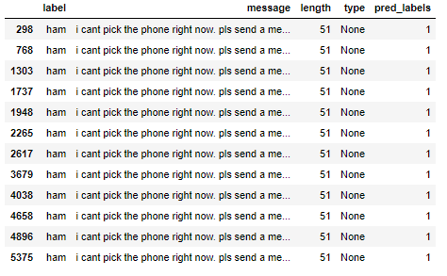
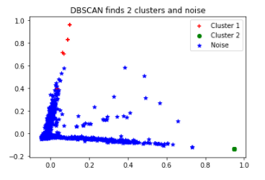
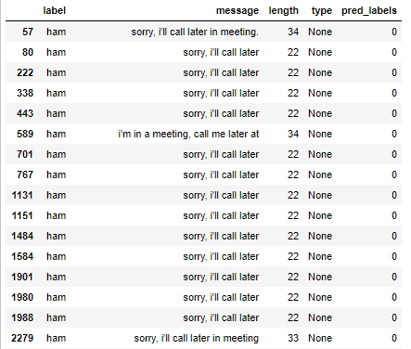
DB Scan:

Slide 12
Thank You!

